Slide 1
20-21. Streams and File I/O
[ECE200016/ITP20003] Java Programming
Notes:
‹#›

Slide 2
Agenda
An Overview of Streams and File I/O
Text File I/O
Techniques for Any File
Binary File I/O
File I/O With Objects and Arrays

Slide 3
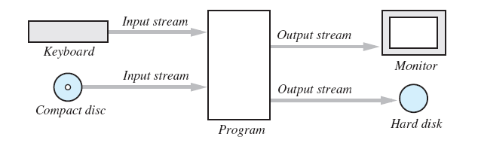
The Concept of a Stream
A stream is a flow of input or output data
Characters, numbers, and bytes
Streams are implemented as objects of special stream classes
Class Scanner
Object System.out

Slide 4
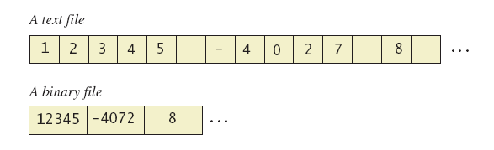
Text Files and Binary Files
Files treated as sequence of characters called text files
Java program source code
Can be viewed, edited with text editor
All other files are called binary files
Movie, music files
Access requires specialized program

Slide 5
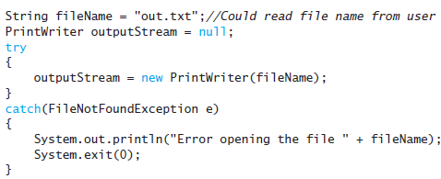
Creating a Text File
Class PrintWriter defines methods needed to create and write to a text file
Must import package java.io
To open the file
Declare stream variable for referencing the stream
Invoke PrintWriter constructor, pass file name as argument
Requires try and catch blocks
https://github.com/lifove/FileIO/blob/master/src/main/java/edu/handong/csee/java/example/PrintWriterDemo.java

Slide 6
Creating a Text File
Opening, writing to file overwrites pre-existing file in directory
File is empty initially
May now be written to with method println
Data goes initially to memory buffer
When buffer full, goes to file
Closing file empties buffer, disconnects from stream
Flushes content of the memory buffer to file.

Slide 7
Creating a Text File
https://github.com/lifove/FileIO/blob/master/src/main/java/edu/handong/csee/java/example/TextFileOutputDemo.java
import java.io.PrintWriter;
import java.io.FileNotFoundException;
import java.util.Scanner;
public class TextFileOutputDemo // Listing 10.1
{
public static void main (String [] args)
{
String fileName = "out.txt"; //The name could be read from the keyboard.
PrintWriter outputStream = null;
try {
outputStream = new PrintWriter (fileName);
} catch (FileNotFoundException e) {
System.out.println ("Error opening the file " + fileName);
System.exit (0);
}
System.out.println ("Enter three lines of text:");
Scanner keyboard = new Scanner (System.in);
for (int count = 1 ; count <= 3 ; count++) {
String line = keyboard.nextLine ();
outputStream.println (count + " " + line);
}
outputStream.close();
System.out.println ("Those lines were written to " + fileName);
}
}

Slide 8

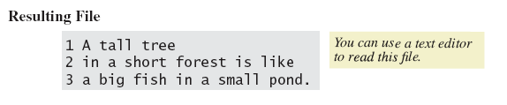
Creating a Text File
Result

Slide 9
Appending to a Text File
https://github.com/lifove/FileIO/blob/master/src/main/java/edu/handong/csee/java/example/TextFileOutputAppendDemo.java
Opening a file new begins with an empty file
If already exists, will be overwritten
Some situations require appending data to existing file
Command could be
outputStream = new PrintWriter(
new FileOutputstream(fileName, true));
See. FileOutputStream
See. FileOutputStream(File file, boolean append)
For more, see http://java.oracle.com
Method println would append data at end

Slide 10
Reading from a Text File
class TextFileInputDemo
Reads text from file, displays on screen
https://github.com/lifove/FileIO/blob/master/src/main/java/edu/handong/csee/java/example/TextFileInputDemo.java
Note
Statement which opens the file
Use of Scanner object
Boolean statement which reads the file and terminates reading loop

Slide 11
Reading from a Text File
import java.util.Scanner;
import java.io.File;
import java.io.FileNotFoundException;
public class TextFileInputDemo
{
public static void main (String [] args)
{
String fileName = "out.txt";
Scanner inputStream = null;
System.out.println ("The file " + fileName + "\ncontains the following lines:\n");
try {
inputStream = new Scanner (new File (fileName));
} catch (FileNotFoundException e) {
System.out.println ("Error opening the file " + fileName);
System.exit (0);
}
while (inputStream.hasNextLine ()) {
String line = inputStream.nextLine ();
System.out.println (line);
}
inputStream.close ();
}
}

Slide 12
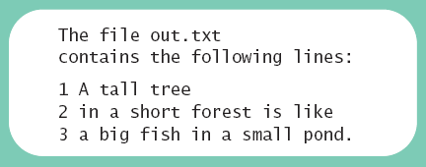
Reading from a Text File
Result

Slide 13
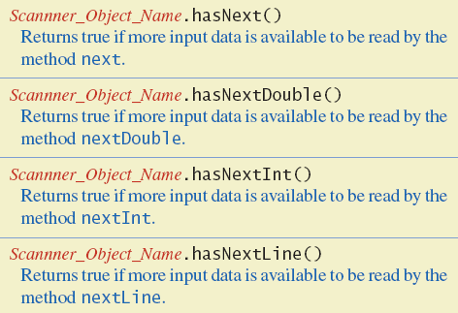
Reading from a Text File
Additional methods in class Scanner
For System.in, they always returns true.

Slide 14
Agenda
An Overview of Streams and File I/O
Text File I/O
Techniques for Any File
Binary File I/O
File I/O With Objects and Arrays

Slide 15
The Class File
A File object represents the name of a file
Ex) new File ("treasure.txt");
Not simply a string
It is an object that knows it is supposed to name a file

Slide 16
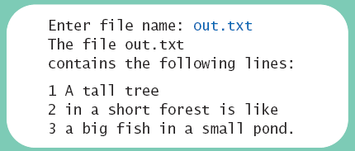
Programming Example
https://github.com/lifove/FileIO/blob/master/src/main/java/edu/handong/csee/java/example/TextFileInputWithUserFileDemo.java
Reading a file name from the keyboard
import java.util.Scanner;
import java.io.File;
import java.io.FileNotFoundException;
public class TextFileInputDemo2
{
public static void main (String [] args)
{
System.out.print ("Enter file name: ");
Scanner keyboard = new Scanner (System.in);
String fileName = keyboard.next ();
Scanner inputStream = null;
System.out.println ("The file " + fileName + "\n" + "contains the following lines:\n");
try {
inputStream = new Scanner (new File (fileName));
} catch (FileNotFoundException e) {
System.out.println ("Error opening the file " + fileName ");
System.exit (0);
}
…
}
}

Slide 17
Using Path Names
Files opened in our examples assumed to be in same folder as where program run
Possible to specify path names
Full path name
Relative path name
Be aware of differences of pathname styles in different operating systems
UNIX style: /usr/bin/ls
Windows style: C:\Windows\system32\cmd.exe

Slide 18
Methods of the Class File
Recall that a File object is a system-independent abstraction of file's path name
File(File parent, String child)
Creates a new File instance from a parent abstract pathname and a child pathname string.
File(String parent, String child)
Creates a new File instance from a parent pathname string and a child pathname string.
Class File has methods to access information about a path and the files in it
Whether the file exists
Whether it is specified as readable or not
Etc.

Slide 19
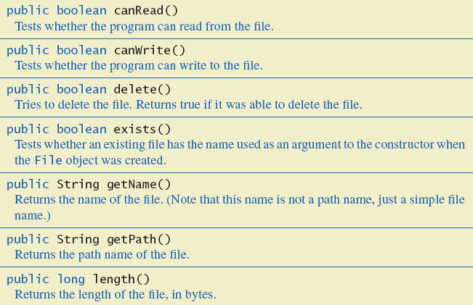
Methods of the Class File
Some methods in class File

Slide 20
Defining a Method to Open a Stream
Method will have a String parameter
The file name
Method will return the stream object
Will throw exceptions
If file not found
If some other I/O problem arises

Slide 21
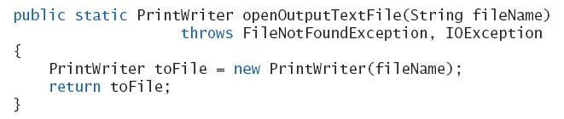
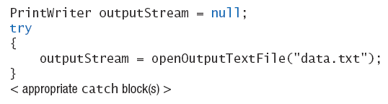
Defining a Method to Open a Stream
Should be invoked inside a try block and have appropriate catch block
Ex)
Ex)

Slide 22
Case Study: Processing a Comma-Separated Values File
A comma-separated values (CSV) file is a simple text format used to store a list of records
Example from log of a cash register’s transactions for the day:
SKU,Quantity,Price,Description
4039,50,0.99,SODA
9100,5,9.50,T-SHIRT
1949,30,110.00,JAVA PROGRAMMING TEXTBOOK
5199,25,1.50,COOKIE
SKU(stock keeping unit): a distinct item, such as a product or service.

Slide 23
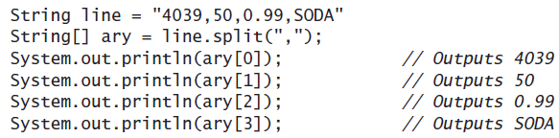
Example Processing a CSV File
class TransactionReader
https://github.com/lifove/FileIO/blob/master/src/main/java/edu/handong/csee/java/example/TransactionReader.java
Uses the split method which puts strings separated by a delimiter into an array

Slide 24
Various file reading approaches
Lab15
JC's FileUtil
https://github.com/lifove/JCTools/blob/master/src/main/java/net/lifove/research/utils/FileUtil.java

Slide 25
Agenda
An Overview of Streams and File I/O
Text File I/O
Techniques for Any File
Binary File I/O
File I/O With Objects and Arrays

Slide 26
Why Binary?
Efficient!
Writing '1234567890' in a text file or a binary file???
Memory use for primitive types (roughly)
int
4 byte + additional 6 bytes = 10 bytes
char (ASCII)
1 byte * 10 + additional 3 bytes = 13 bytes
20 integers vs 20 strings
int: 4 * 20 + 6 = 86 bytes
char: 1 * 10 * 20 + 3 = 203 bytes
https://docs.google.com/presentation/d/1eJLyN9dHnEZRPdgb9R9iJDJs0DAgR-UFZEvh5x6fAaw/edit#slide=id.p12

Slide 27
Creating a Binary File
Stream class ObjectOutputStream allows files which can store values of primitive types, strings, and other objects
Creating a binary file
Ex) ObjectOutputStream outputStream =
new ObjectOutputStream (new FileOutputStream (fileName));
Constructor for ObjectOutputStream cannot take a String parameter
Constructor for FileOutputSream can take a String parameter
Writing an integer value into a binary file
Ex) outputStream.writeInt(anInteger);
Closing a binary file
Ex) outputStream.close ();

Slide 28
Filters (== Decorators)
Example
ObjectOutputStream outputStream =
new ObjectOutputStream(
new BufferedOutputStream(
new FileOutputStream(fileName)));
outputStream
ObjectOutputStream
BufferedOutputStream
FileOutputStream
file

Slide 29

Creating a Binary File
class BinaryOutputDemo
https://github.com/lifove/FileIO/blob/master/src/main/java/edu/handong/csee/java/example/binarydemo/BinaryOutputDemo.java
Result

Slide 30
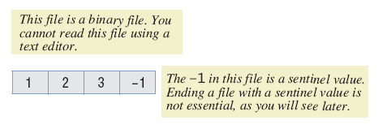
Writing Primitive Values to a Binary File
Method println() is not available
Instead, use writeInt() method
Binary file stores numbers in binary form
A sequence of bytes one immediately after another

Slide 31
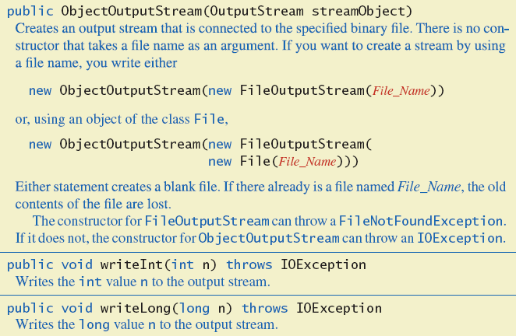
Writing Primitive Values to a Binary File
Some methods in class ObjectOutputStream

Slide 32
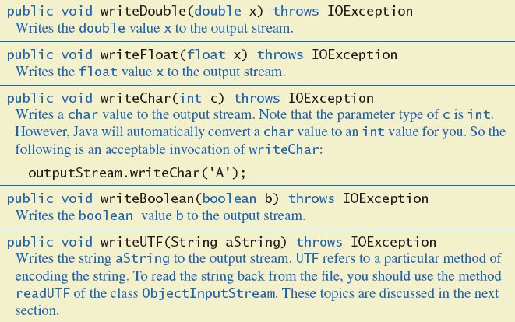
Writing Primitive Values to a Binary File
Some methods in class ObjectOutputStream

Slide 33
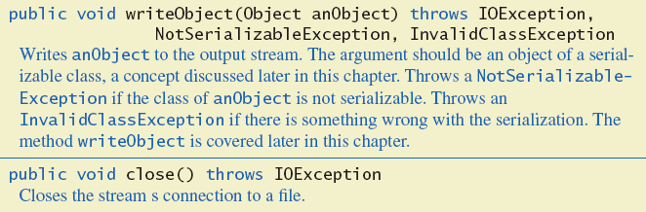
Writing Primitive Values to a Binary File
Some methods in class ObjectOutputStream

Slide 34
Writing Strings to a Binary File
Use method writeUTF
Ex) outputStream.writeUTF("Hi Mom");
UTF stands for Unicode Text Format
If you want to write ASCII string, it is recommended to use the PrintWriter class
Uses a varying number of bytes to store different strings
Depends on length of string
Contrast to writeInt which uses same for each

Slide 35
Reading from a Binary File
File must be opened as an ObjectInputStream
Read from binary file using methods which correspond to write methods
Integer written with writeInt will be read with readInt
Be careful to read same type as was written

Slide 36
Opening Files
Example
ObjectInputStream in = new ObjectInputStream(
new BufferedInputStream(
new FileInputStream(file_name)));
file
FileInputStream
BufferedInputStream
ObjectInputStream
in

Slide 37
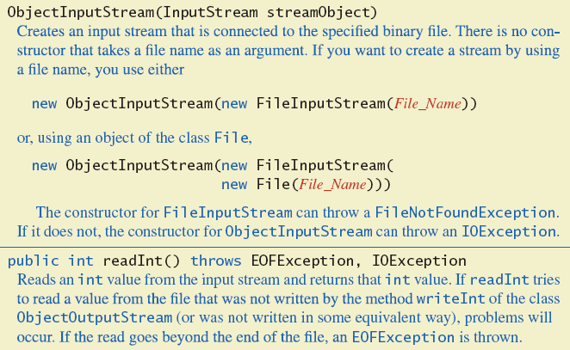
Reading from a Binary File
Some methods of class ObjectInputStream

Slide 38
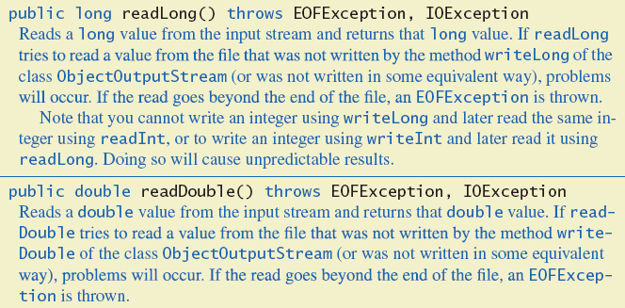
Reading from a Binary File
Some methods of class ObjectInputStream

Slide 39
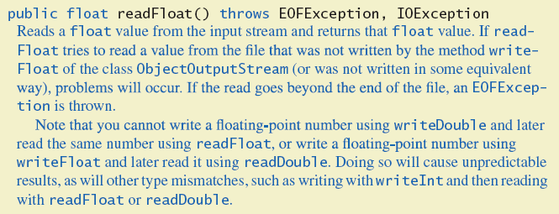
Reading from a Binary File
Some methods of class ObjectInputStream

Slide 40
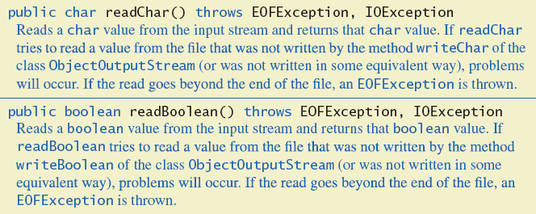
Reading from a Binary File
Some methods of class ObjectInputStream

Slide 41
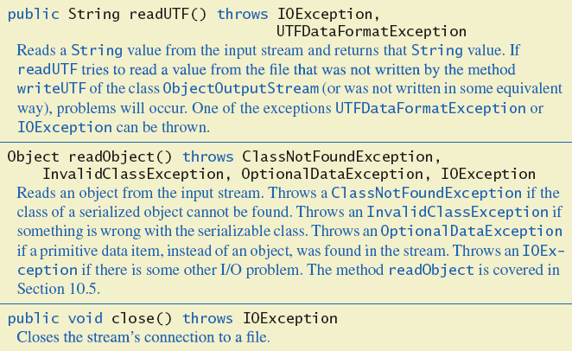
Reading from a Binary File
Some methods of class ObjectInputStream

Slide 42
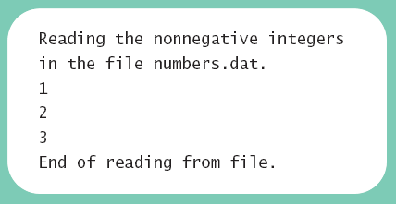
Reading from a Binary File
class BinaryInputDemo
https://github.com/lifove/FileIO/blob/master/src/main/java/edu/handong/csee/java/example/binarydemo/BinaryInputDemo.java

Slide 43
The Class EOFException
Many methods that read from a binary file will throw an EOFException
Can be used to test for end of file
Thus it can end a reading loop
class BinaryInputEOFDemo
https://github.com/lifove/FileIO/blob/master/src/main/java/edu/handong/csee/java/example/binarydemo/BinaryInputEOFDemo.java
try {
while (true) {
int anInteger = inputStream.readInt ();
System.out.println (anInteger);
}
} catch (EOFException e) {
System.out.println ("Reached end of the file.");
}

Slide 44
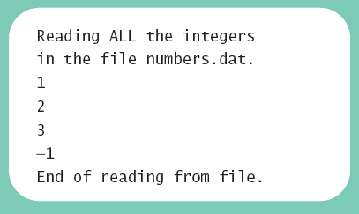
The Class EOFException
Note the -1 formerly needed as a sentinel value is now also read
Always a good idea to check for end of file even if you have a sentinel value

Slide 45
Programming Example
Processing a file of binary data
Asks user for 2 file names
Reads numbers in input file
Doubles them
Writes them to output file
class Doubler
https://github.com/lifove/FileIO/blob/master/src/main/java/edu/handong/csee/java/example/binarydemo/Doubler.java

Slide 46
Agenda
An Overview of Streams and File I/O
Text File I/O
Techniques for Any File
Binary File I/O
File I/O With Objects and Arrays

Slide 47
Binary-File I/O with Class Objects
Consider the need to write/read objects other than Strings
Possible to write the individual instance variable values
Then reconstruct the object when file is read
A better way is provided by Java
Object serialization – represent an object as a sequence of bytes to be written/read
Possible for any class implementing Serializable

Slide 48
Binary-File I/O with Class Objects
Interface Serializable is an empty interface
No need to implement additional methods
Tells Java to make the class serializable (class objects convertible to sequence of bytes)
class Species implements Serializable
https://github.com/lifove/FileIO/blob/master/src/main/java/edu/handong/csee/java/example/serializable/Species.java

Slide 49
Binary-File I/O with Class Objects
Once we have a class that is specified as Serializable we can
Write objects to a binary file with method writeObject
Ex) outputStream.writeObject (califCondor);
Read objects with method readObject
Ex) readOne = (Species) inputStream.readObject ();
Also required to use typecast of the object
class ObjectIODemo
https://github.com/lifove/FileIO/blob/master/src/main/java/edu/handong/csee/java/example/serializable/ClassObjectIODemo.java

Slide 50
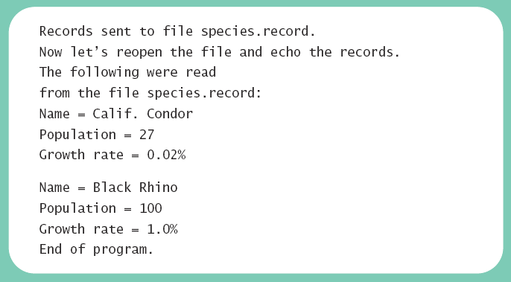
Binary-File I/O with Class Objects
Result

Slide 51
Some Details of Serialization
Requirements for a class to be serializable
Implements interface Serializable
Any instance variables of a class type are also objects of a serializable class
Exception: transient variables
Class's direct superclass (if any) is either serializable or defines a default constructor

Slide 52
Some Details of Serialization
Effects of making a class serializable
Affects how Java performs I/O with class objects
Java assigns a serial number to each object of the class that it writes to the ObjectOutputStream
If same object written to stream multiple times, only the serial number written after first time
Exception: reset() method

Slide 53
Array Objects in Binary Files
Since an array is an object, possible to use writeObject with entire array
Similarly use readObject to read entire array
readObject()/writeObject() cannot read/write an array of class objects that are not Serializable.
class ArrayIODemo
https://github.com/lifove/FileIO/blob/master/src/main/java/edu/handong/csee/java/example/serializable/ArrayIODemo.java

Slide 54
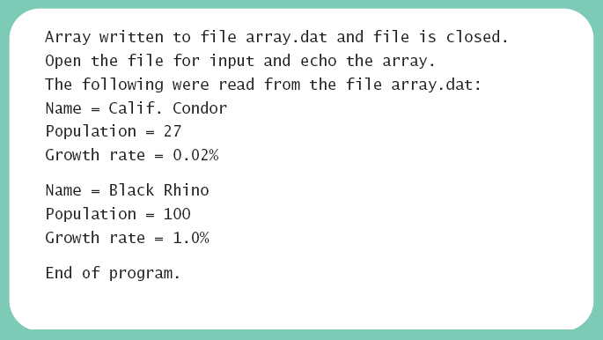
Array Objects in Binary Files
Result

